Slide 1
Analysis of the Housing Market in Two US Cities from 2020-2022
Nikhil Muthuvenkatesh, Seyi Oyesiku, Luqing Qi, Rohan Ukkalam

Slide 2
Introduction & Motivation
At the start of the pandemic, there was a steep drop in real estate pricing, and then a large spike in pricing that has climbed until now.
Because of this, the team wanted to use real estate data from these last two years to try to predict what real estate pricing will be like in Pennsylvania and New York next year.
The motivation behind this project was from the group members, all of whom are interested in pursuing real estate after graduation. We wanted to understand where the market was going.

Slide 3
Potential Stakeholders
Anyone looking to buy a home within the next year or two would find this study helpful
Also, it could be useful for banks that provide home loans, mortgage companies, and escrow companies

Slide 4
Project Goal
The goal of this project is to use real estate data from 2020-2022 to train a model that is able to predict real estate pricing in the future. We will attempt to use supervised learning with this model by giving our model the labels and outputs that were expected in the training set. This will allow us to use the factors that we trained the model with to find out what the pricing of housing would look like in the cities we chose.
The end result of this product will take a current table of listings, and then try to populate the dataset with pricing that it predicts for those houses/apartments. The model will use the columns in the dataset such as neighborhood, year built, and any other predictors that we used in the training phase.

Slide 5
Current housing market trends
“The nation’s overall housing supply remains limited, as those who purchased homes in recent years at extremely low mortgage rates are staying put. This tight inventory has kept prices from seeing deeper declines, making homes still unaffordable for many, especially first-time homebuyers.”
https://www.forbes.com/advisor/mortgages/real-estate/housing-market-predictions/
November 29 Robin Rothstein Forbes Advisor Staff
“The housing market is predicted to slow down further in the last quarter of 2022. For sellers, this could be terrible news, but for buyers, it's great. Yet, there is still the problem of sky-high mortgage rates. The bright side is that if buyers hold off, the supply of homes will increase, putting further pressure on sellers to decrease prices. This would constitute a long-overdue course correction for the housing market.”
https://www.noradarealestate.com/blog/housing-market-trends/
November 26, 2022 By Marco Santarelli

Slide 6
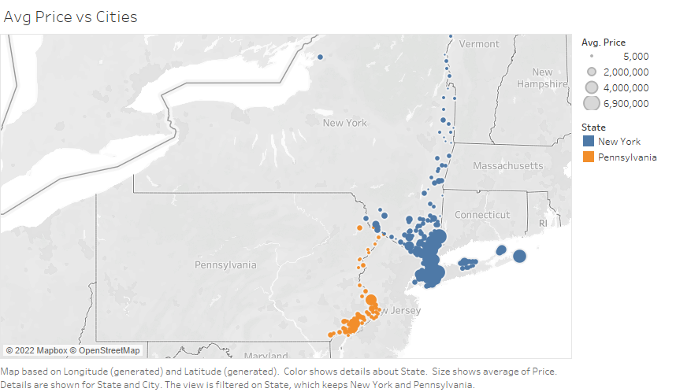
Average Price Across NY and PA

Slide 7
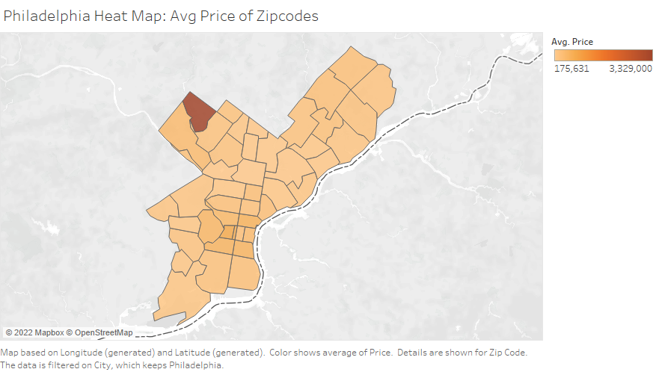
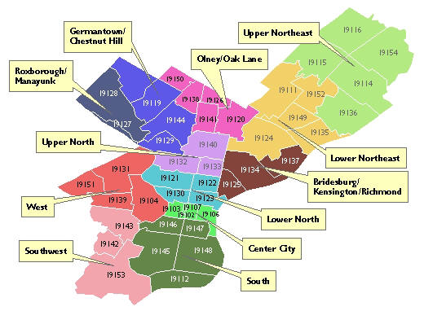
Philadelphia Zip Codes Avg Prices
This is a heatmap of average prices across the various zip codes present in our Philadelphia data. For comparison is another map of counties to the left. We can see that Germantown/Chestnut Hill seems to be the most expensive, property wise

Slide 8
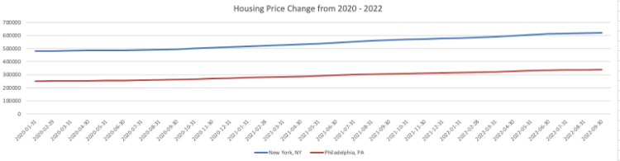
Price Difference for Philadelphia and New York Between 2020 - 2022

Slide 9

New York City Real Estate Market Study
New York City was chosen because it is the most expensive city to live in in the United States
When we viewed the mean price change in New York, it started at around $480,000 in 2020, and has climbed up to a mean price of $600,000 in September 2022.
The mean prices in each borough of the city is discussed later, as well, and it shows why it was an interesting city for us to study.

Slide 10
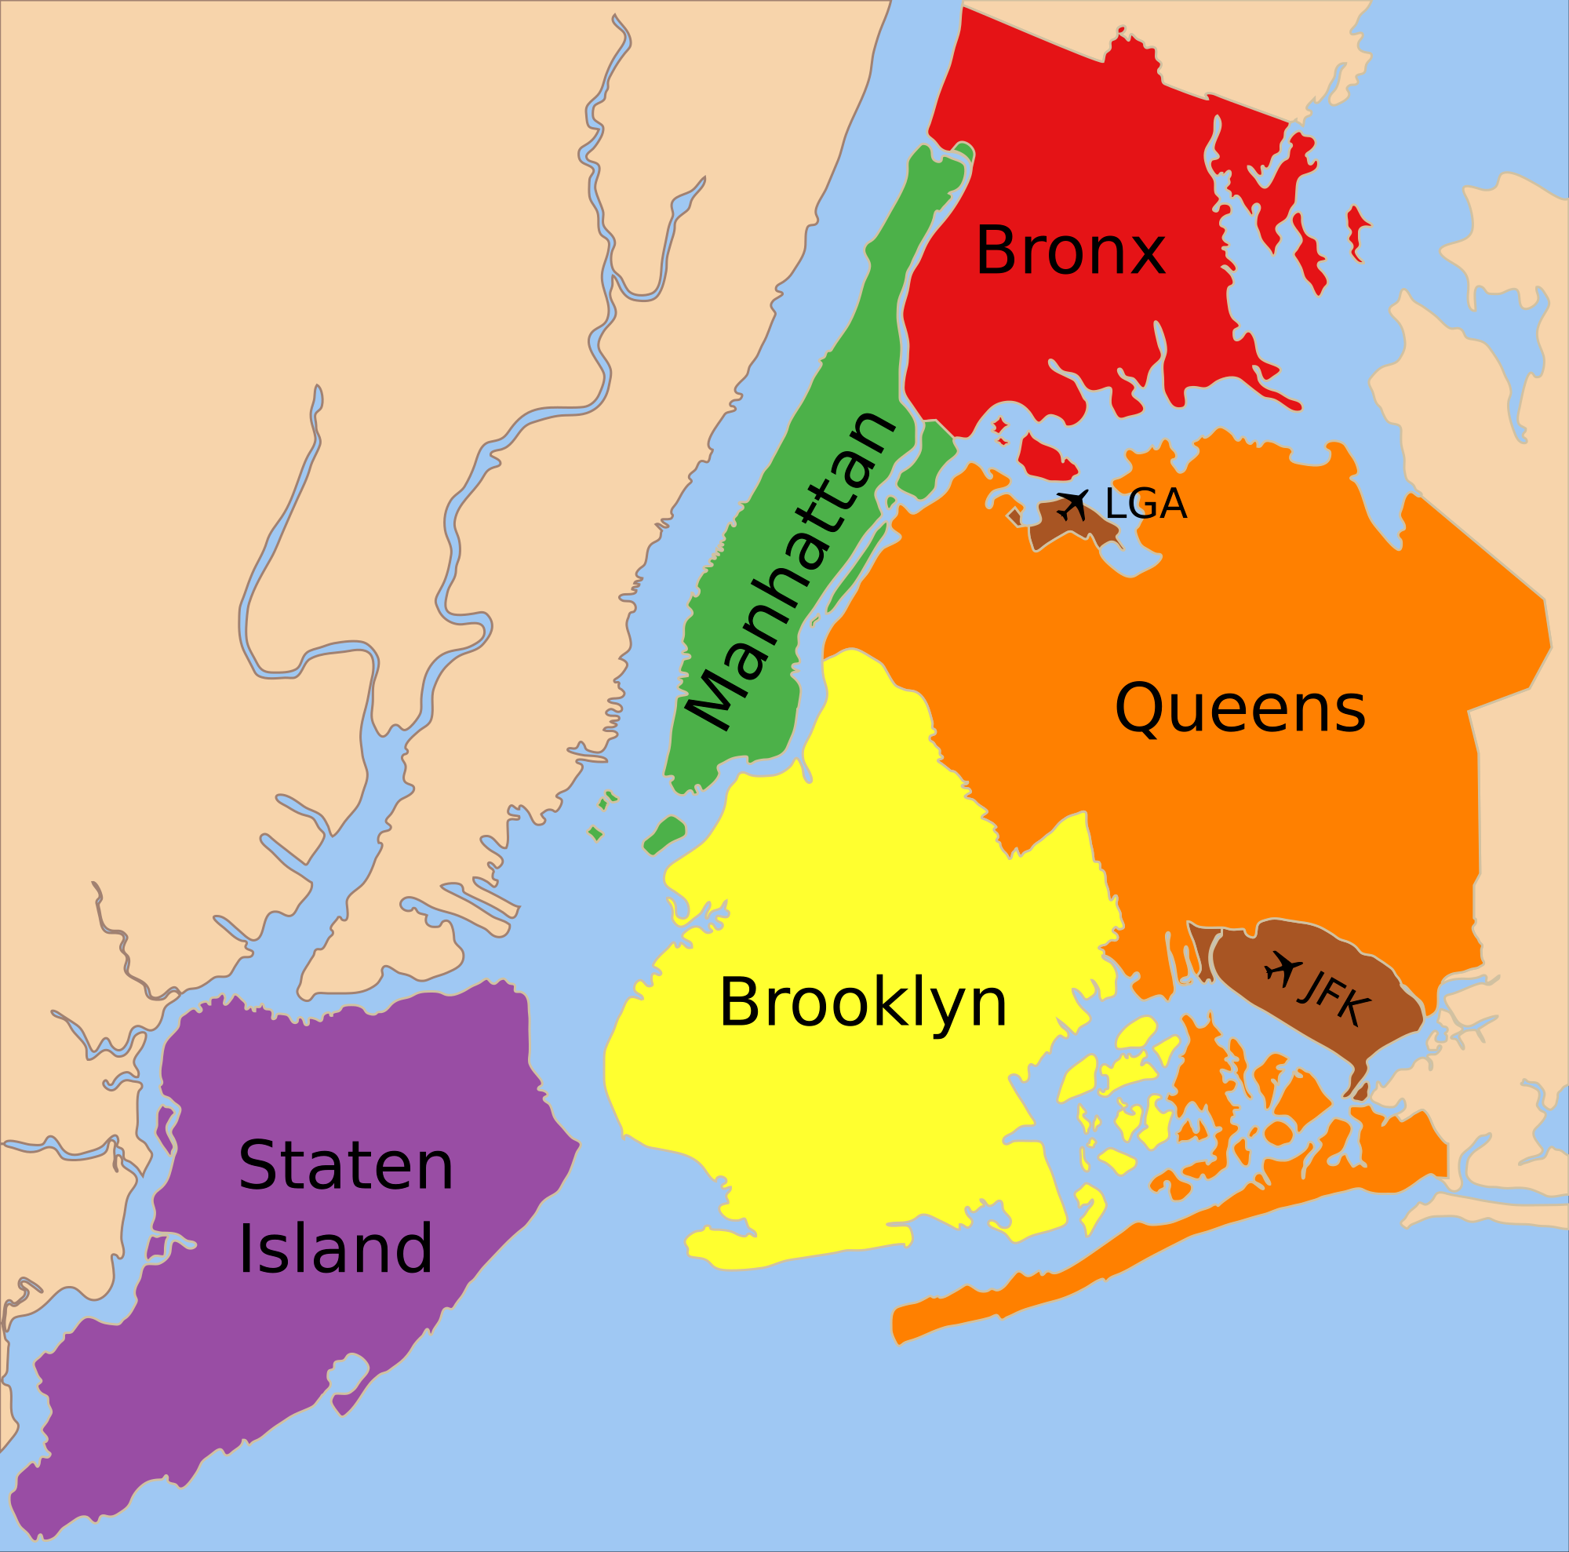
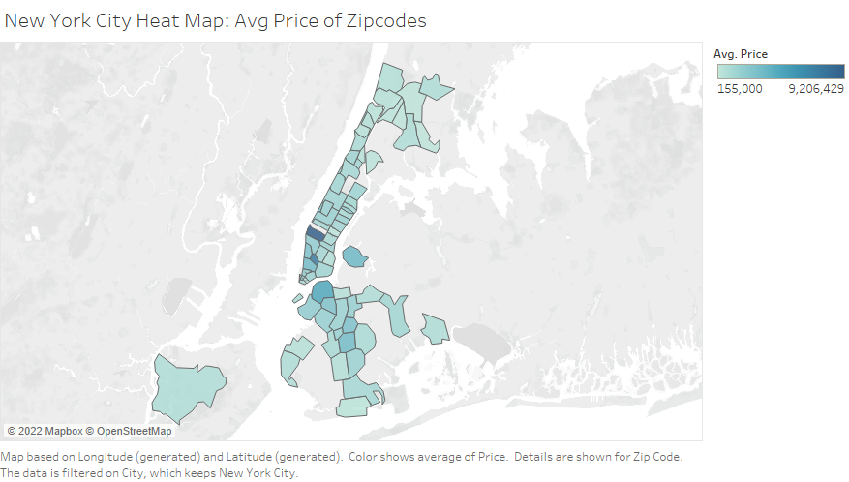
New York City Zip Codes Avg Prices
This is a heatmap of average prices across the various zip codes present in our New York City realtor data. For comparison is another map to the left. We can see that the most expensive zip code is in Manhattan, while the next most are in the Brooklyn area.

Slide 11
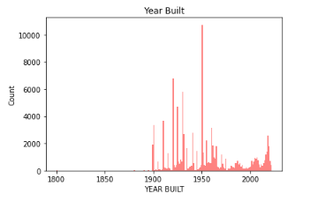
New York City Real Estate Year Built Distribution

Slide 12
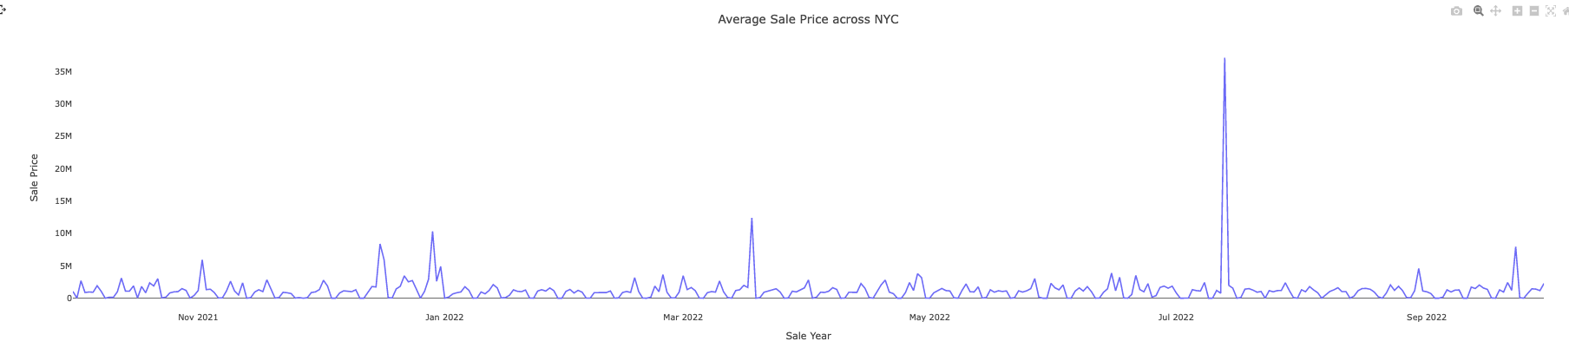
Average Price in 2021 to 2022

Slide 13
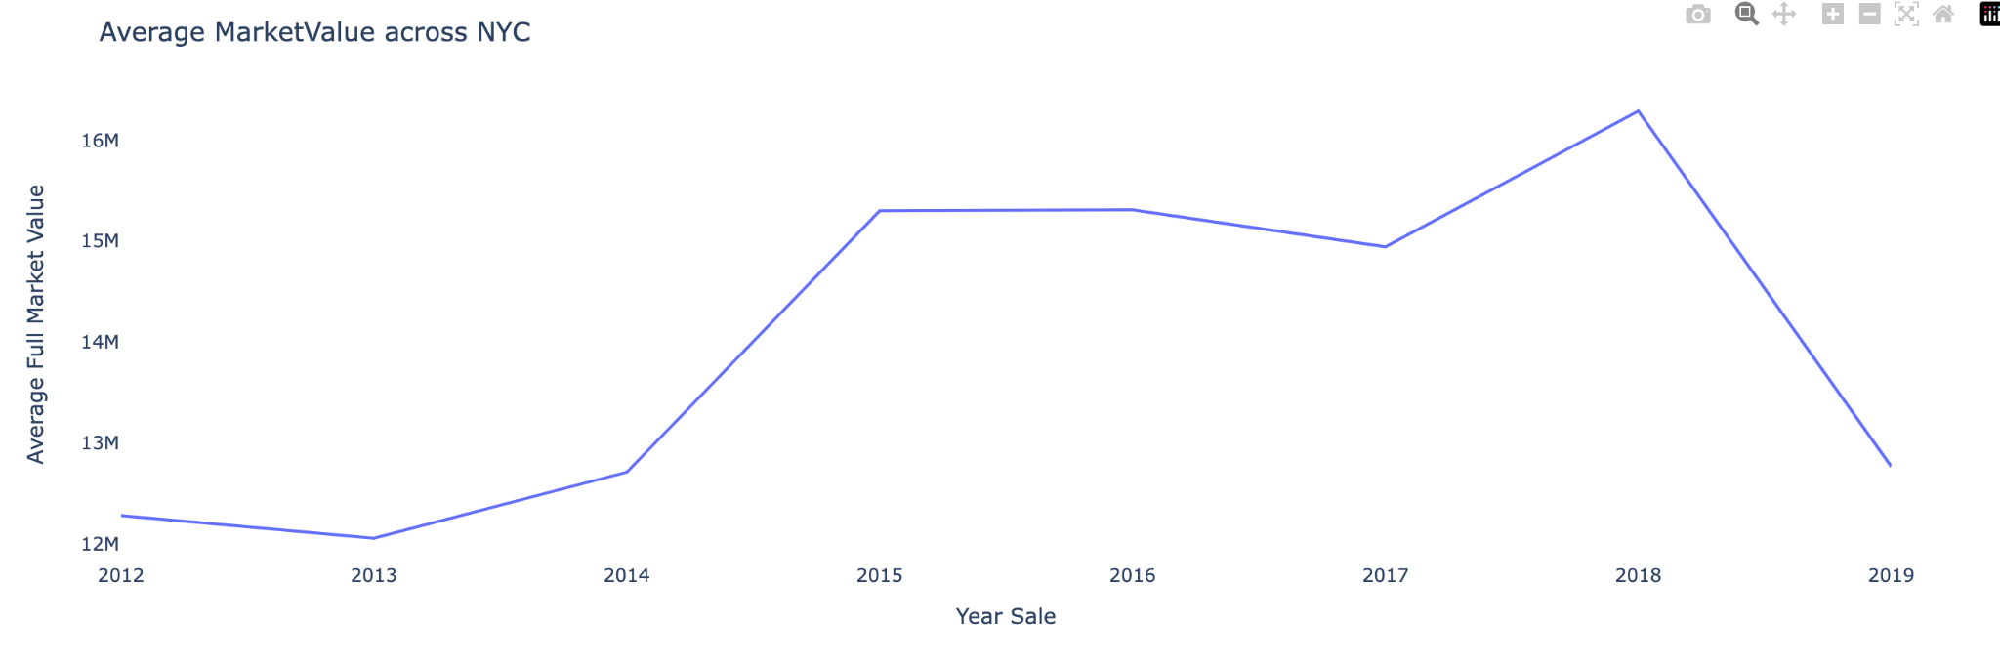
Average Market Value Across NYC From 2012 to 2019

Slide 14
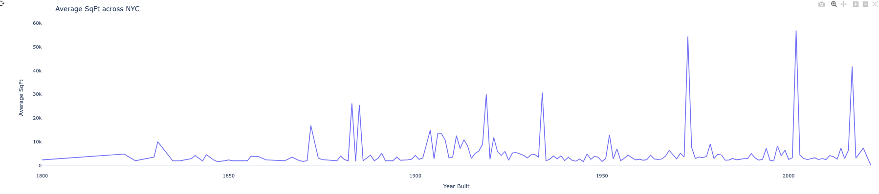
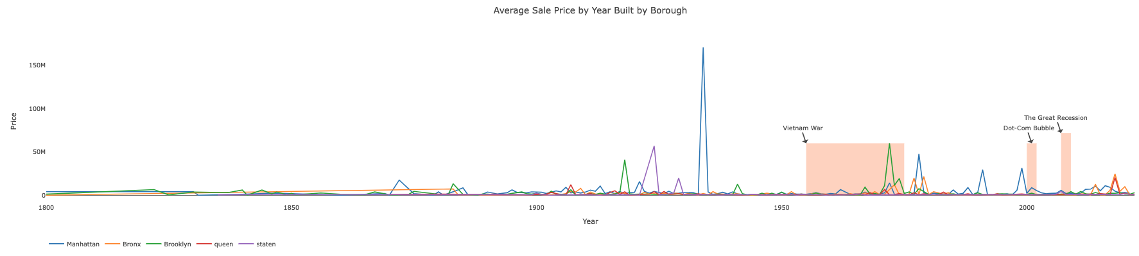

Slide 15
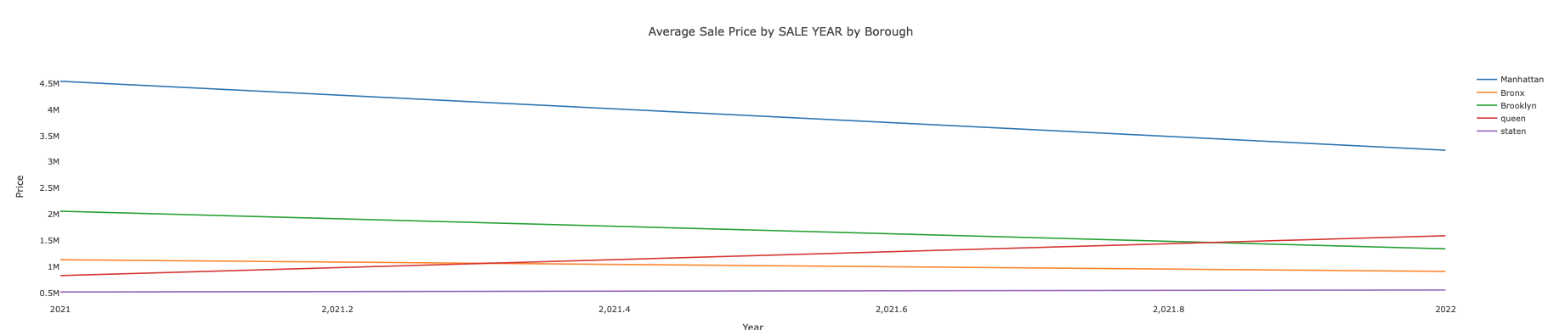
Average Sale Price By Year by Brough

Slide 16
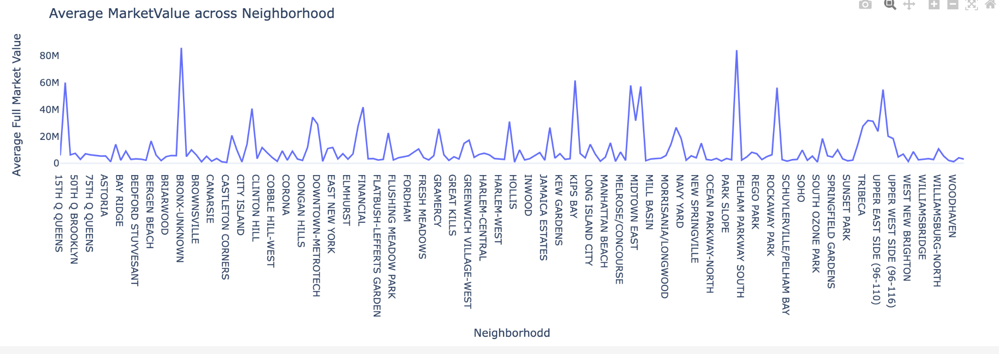
Top 3 Neighborhood with the Highest Average Market Value
1.PARKCHESTER $860,415,26
2. KIPS BAY $616,064,83
3. MIDTOWN CBD $580,616,03

Slide 17
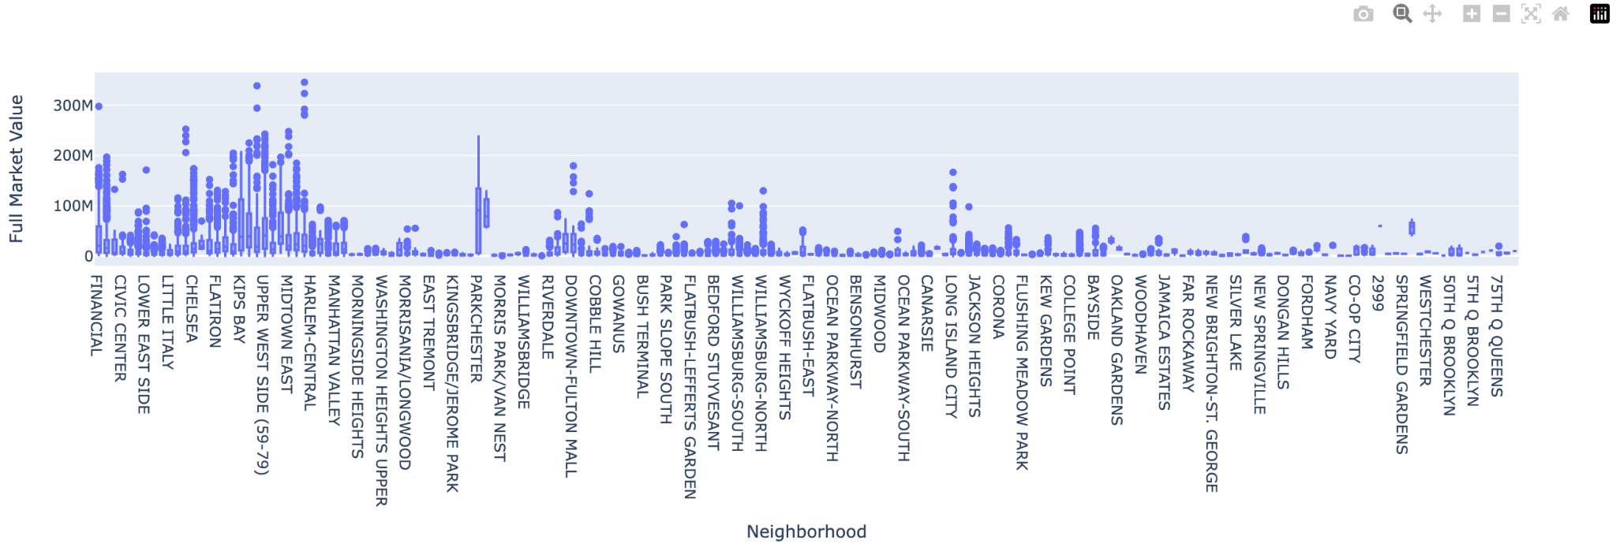
Top 3 Neighborhood with the Highest Market Value
Upper East Side(79-96) $346.133M
CLINTON $339.085M
FINANCIAL $298.131M

Slide 18
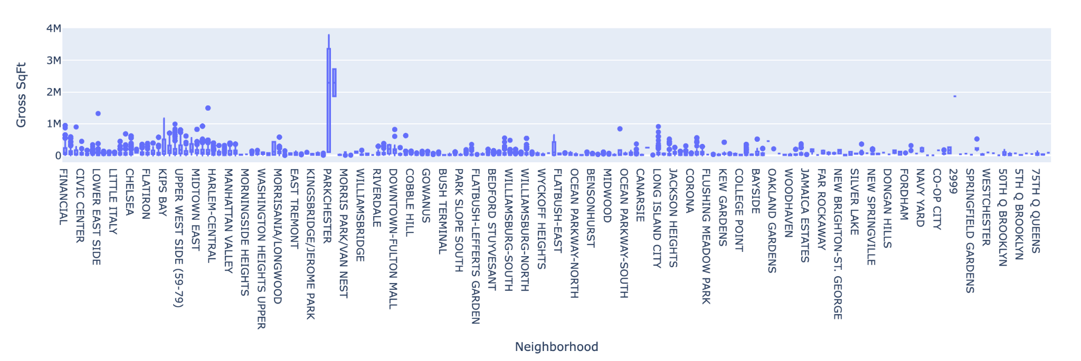
Parkchester, Bronx have the highest a median Gross sq ft
2.30 M sq ft

Slide 19
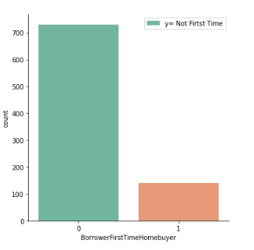
Demographics Distribution
In our dataset, we noticed that the bank allowed each mortgage have two borrowers. We did some basic demographics analysis about the borrowers.
Income Average Total Monthly Income Amount equal to $10872.35
Month Most of the Mortgages browser have 360 months to pay back their loan
Interest Rate Average Mortgage interest range equal to 2.84
Average Mortgage amount equal to $227637.9
Average age for Borrower one equal to 44
Average age for Borrower two equal to 68
Race Majority of population White

Slide 20
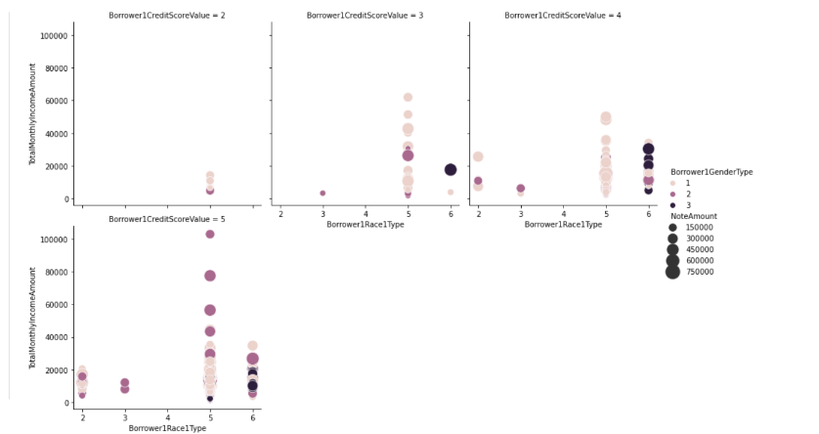
Credit Score, Gender, Income, & NoteAmount
From this graph, we could see that whites can borrow more than other groups with the same credit score.
We also found that white women tended to borrow more with a credit rating of five.

Slide 21
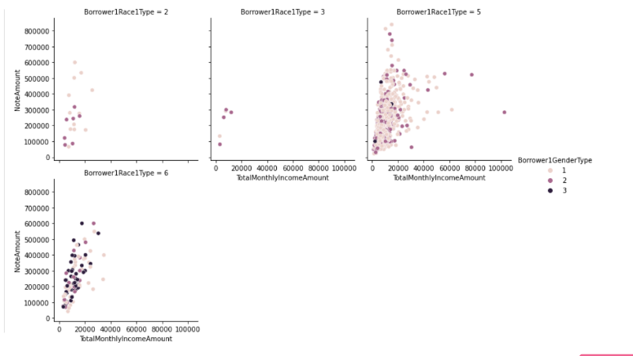
Total Monthly Income Amount vs Amount Money Borrow
We found a positive correlation between monthly income and the number of loans.
At the same time, we found that caucasians have more income and loans than other ethnic groups.

Slide 22
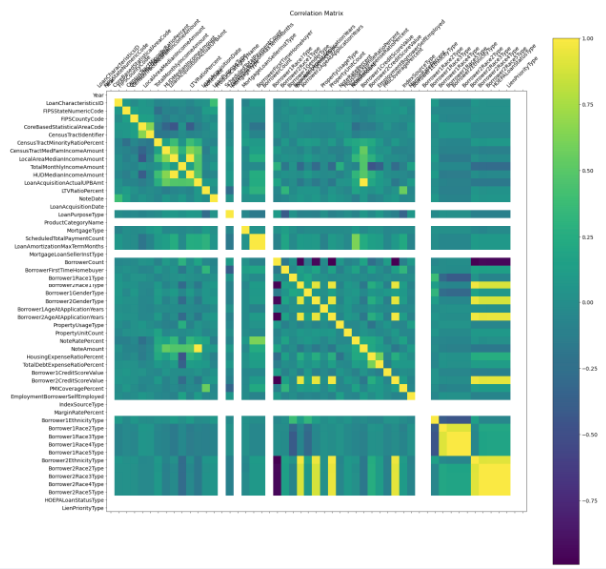
Correlation Matrix
From this graph, we can conclude that three important factors can affect the number of loans you can take:
The number of loans you borrow from the bank.
The median income for the neighborhood where house purchased.
The average monthly income of borrower.

Slide 23
Is 2023 a good time to buy a house ?
“The percentage of respondents who say it is a good time to sell a home decreased from 59% to 51%, while the percentage who say it's a bad time to sell increased from 33% to 42%. As a result, the net share of those who say it is a good time to sell decreased 17 percentage points month over month.”
“In an effort to tamp down inflation, the Federal Reserve is raising interest rates. The Federal Reserve raised the target range for the federal funds rate by 75 bps to 3.75%-4% during its November 2022 meeting. It marks a sixth consecutive rate hike and the fourth straight three-quarter point increase, pushing borrowing costs to a new high since 2008.”
https://www.noradarealestate.com/blog/is-it-a-good-time-to-buy-a-house/
December 7, 2022 By Marco Santarelli

Slide 24
Limitations and Future work
We were limited by the features that were available to us by our datasets. There are economic factors that could be considered in future work.
We limited our study to Philadelphia and New York, but there are many other cities in the United States with a growing real estate market. One example is Phoenix, Arizona, where there is a large amount of new communities that have been built there over the last two years.
We will be continuing our work by choosing models to use for predicting pricing with our data next term. Since we do have a target variable pricing, we will need to use only supervised learning methods. Since the number of features we might use for analysis would be fewer than 20, we could potentially use K-Nearest Neighbors. In addition, other options for us would be a Random Forest or Logistic Regression. For our machine learning model, we want to use Loan-level Public-Use Databases (PUDBs) data to predict the most important factor influencing the interest ratio and interest amount. The model we could use include: Decision tree, Random Forest, Neural Network, and Linear Regression.
We will keep exploring the feature in the public data for the real estate market in New York and Philadelphia. The new dataset we plan to use is Condominium Comparable Rental Income in NYC.

Slide 25
Github
https://github.com/Unlessitoldyou/DSCI-Capstone1

Slide 26
Thank You

